Slide 1
Import and Require

Slide 2
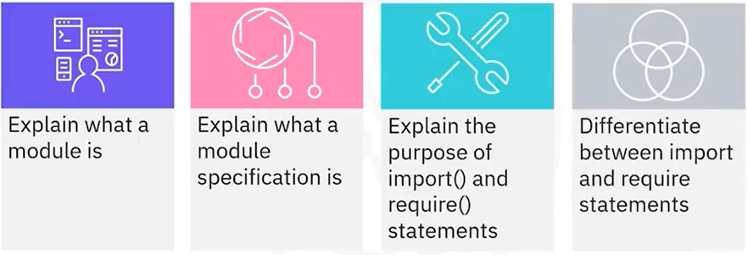
What you will learn

Slide 3
Modules
• Related, encapsulated JavaScript code
• Serves a single purpose
• Can be a single file or a folder containing files
• Reusable
• Breaks down complex code into manageable chunks

Slide 4
Purpose of import() and require()
• When an external application needs to use the code in a
module
applicationABC
needs moduleXYZ
moduleXYZ
import()
require()

Slide 5

Packages and specifications
Module specifications:
Conventions and standards
used to create packages
CommonJS
ES
Package: a directory
with one or more
modules

Slide 6





Enable ES modules

Slide 7
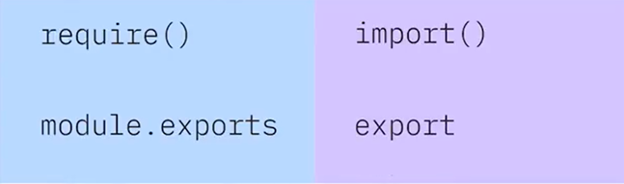
Importing and exporting modules
commonJS
ES
import a module
export from a module

Slide 8
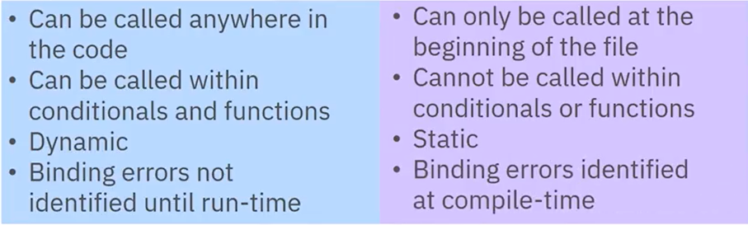
Differences calling require() and import()
require()
import ( )

Slide 9
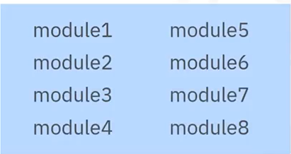
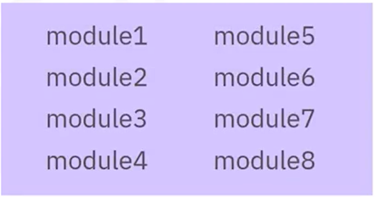
Synchronous vs asynchronous
require ( )
• Synchronous
import ( )
• Asynchronous

Slide 10
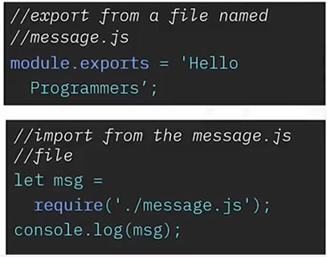
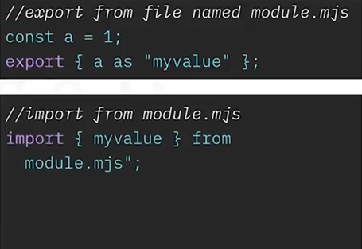
Sample code
require()
import ( )

Slide 11
Recap
In this video, you learned that:
• A module is a file containing related JavaScript functions that serves a specific purpose
• Module specifications are conventions and standards used to create packages in JavaScript code
• import() and require() statements are used to call a module or a package into an external application
• The require() statement can be called from anywhere in the app code, is bound dynamically, and is synchronous
• The import() statement can only be called at the beginning of a file, is bound statically, and is asynchronous

